Slide 1
JAVA PROGRAM AND PROGRAM STRUCUTRE

Slide 2

Java First Program

Slide 3
Class Declaration
class : keyword
SampleOne : Identifier
Syntax :
class <class_name>
Notes:
Class Declaration :
Class is object oriented COnstruct
Everything must be placed inside class
class-keyword
SampleOne is identifier

Slide 4
Opening and Closing Braces
Class definition begins: Opening Braces
Ends with : Closing Braces

Slide 5
Main Declaration
Main : starts execution
Every java program will have main
Many classes and only one main class
Public : access specifier
unprotected
Static : keyword
accessible by all class
Void: return type modifier
does not return anything

Slide 6
Output Line
Writes to standard output
Like C and C++
Java statement ends with semicolon

Slide 7
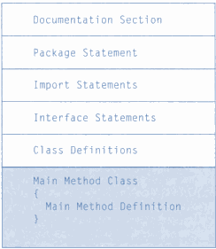
Program Structure

Slide 8
Documentation
Includes : description, time, Date and also author name
Why and what is included
Comment
/** ….*/

Slide 9
Package Statement
Defines where the java class is.
First statement of program
Syntax:
Package <package_name>;

Slide 10
Import Statement
Similar to include
Intrepreter to include class
Syntax
Import <class_name>;

Slide 11
Class Defnition
Primary and Essential Element
Everything is inside class
Can have any number of class

Slide 12
Main Method Class
Starting Point
Creates object of different class
Creates communication between object.

Slide 13
END

